Slide 1
Types of RNN

Slide 2
Types of RNN
One-to-Many
Many-to-One
Many-to-Many

Slide 3
One-to-Many
A single input (or fixed-length vector) generates a sequence of outputs.
Image Captioning
CNN encodes an image into a feature vector.
An RNN decoder takes that vector as its initial hidden state and emits a word at each time step: “A” → “dog” → “running” → … → <END>.

Slide 4
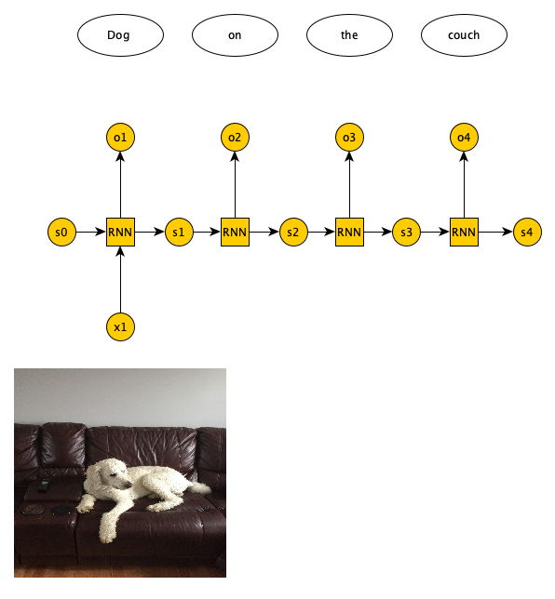
One-to-Many
https://training.galaxyproject.org/training-material/topics/statistics/tutorials/RNN/slides-plain.html

Slide 5
Many-to-One
A whole input sequence is read in; after the final time step, the model emits a single output.
You unroll the RNN over all timesteps, then apply (e.g.) a dense layer to the last hidden state.

Slide 6
Many-to-One
Example:
Sentiment Classification
Input: the word sequence of a movie review.
Output: one scalar (e.g. positive vs. negative) based on the final hidden state.
Sequence Regression
Predicting tomorrow’s stock price from the past week’s closing prices.

Slide 7
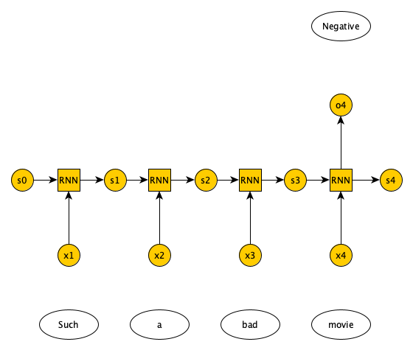
Many-to-One
https://training.galaxyproject.org/training-material/topics/statistics/tutorials/RNN/slides-plain.html

Slide 8
Many-to-Many
Synchronized (Output length = Input length)
Definition: One output for each input time step.
Example:
Part-of-Speech Tagging
At each word in the sentence, you tag it as noun/verb/etc.
Named-Entity Recognition
Emit a label for every token (“O”, “B-PERSON”, “I-ORG”, …).

Slide 9
Many-to-Many
Unsynchronized (Output length ≠ Input length)
Definition: You read the entire input sequence, then generate an output sequence (of different length).
Example:
Machine Translation
Encoder RNN reads all words of the source sentence.
Decoder RNN then produces the target sentence one word at a time.

Slide 10
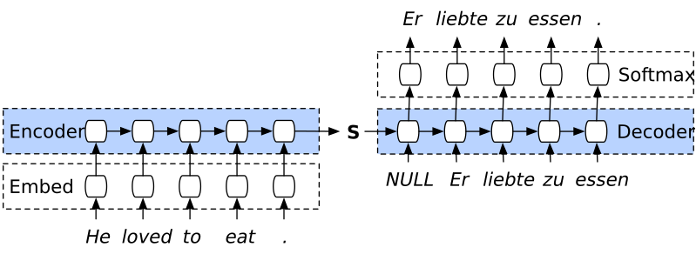
Many-to-Many

